Slide 1

ALPHABET BOOK FROM 4e7
Good uses of internet and social networks

Slide 2


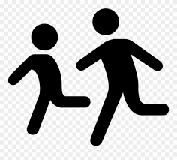
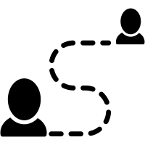
Be careful About the information you give.
Be careful about the information you put on social media.
Don’t forget, you could sometimes take a break and go outside.
Don’t give too much personal information, it can be dangerous for you.
Thanks to social networks, it’s so Easy to keep in touch with friends and family.

Slide 3



Social networks are Fabulous because you can communicate with your friends and
family very easily.
Internet can be very useful to Get the news.
Don’t spend too much time on screens, it is not very Healthy.
Internet is not personal: you can be watched over.
Justice for people who get bullied on internet.

Slide 4



Thanks to internet, you can Keep in touch with your friends, it’s so easy to communicate.
It is also so useful to Look for a lot of information.
You Mustn’t expose your private life too much on social networks, it can be dangerous.
On social Networks: No personal information, No personal photos.
On internet, be a smart and intelligent person.

Slide 5
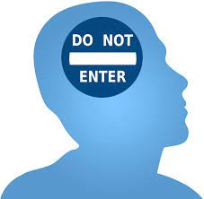

Don’t Post your Private life on internet: Private life is Private.
Don’t ask personal Questions to people you don’t know.
We have to be Responsible about what we do on internet.
Don’t Spend too much time on social networks, you can become addicted.
Thanks to internet, we can communicate easily, find information. It’s so Useful.

Slide 6

Social networks can be Very dangerous if you don’t respect the rules.
Warning: there are fake news on social networks.
You can eXplore and find varied topics on internet.
You can post photos and comments but you should be careful because
internet keeps your information.
If you spend too much time on screens, you can be addicted and act like a Zombie.

